Slide 1

Network Intrusion Detection System

Slide 2

Supervised by Dr.Maggie Ezzat
German University in Cairo
Presented by :
Nourhan Reda Abdellal
Khaled Badr El Toukhy
Nardeen Shaher Abdo

Slide 3

Presentation outline:
Introduction
Data exploration
Data preprocessing
Handling class imbalance
Binary classification
Multi classification

Slide 4
Intro to Intrusion Detection Systems

Slide 5
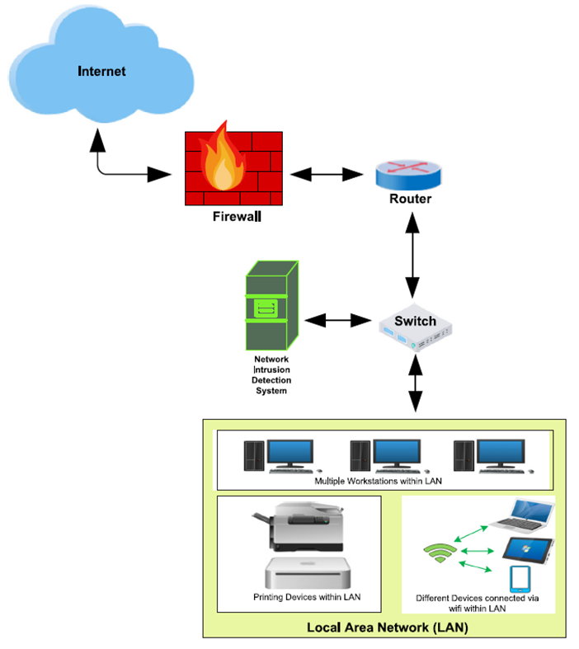
Abstract
Network intrusion detection systems (NIDS) are the most common tool used to detect malicious attacks on a network. They help prevent the ever-increasing different attacks and provide better security for the network. NIDS are classified into signature-based and anomaly-based detection. The most common type of NIDS is the anomaly-based NIDS which is based on machine learning models and is able to detect attacks with high accuracy.
•NIDS is implemented in the form of a device or software that monitors all traffic passing through a strategic point in the network for malicious activities.
It is typically deployed at a single point, for example, it can be connected to the network switch (as in the figure)
If malicious behavior is detected, NIDS will generate alerts to the host or network administrators.

Slide 6
Goals of NIDS
•The main goals of NIDS include:
1.Detect wide variety of intrusions
O Previously known and unknown attacks
O Suggests if there is a need to learn/adapt to new attacks or change in behavior
2.Detect intrusions in timely fashion
O And minimize the time spent verifying attacks
O Depending on the system criticality, it may be required to operate in real-time, especially when the system responds to (and not only monitors) intrusions
– Problem: analyzing commands may impact the response time of the system
3.Present the analysis in a simple, easy-to-understand format
O Ideally as a binary indicator (normal vs malicious activities)
O Usually the analysis is more complex (than a binary output), and security analysts are required to examine suspected attacks
O The user interface is critical, especially when monitoring large systems
4.Is accurate
O Minimize false positives, false negatives

Slide 7
NIDS with Machine Learning
• Enormous increase in network traffic in recent years and the resulting security threats are posing many challenges for detecting malicious network intrusions.
• To address these challenges, ML and DL-based NIDS have been implemented for detecting network intrusions.
• Anomaly detection has been the main focus of these methods, due to the potential for detecting new types of attacks.
• In the remainder of the lecture, we will first overview the datasets that are commonly used for training and evaluating ML-based NIDS, followed by a description of the ML models used for anomaly detection, and followed by adversarial attacks on ML models for NIDS.

Slide 8
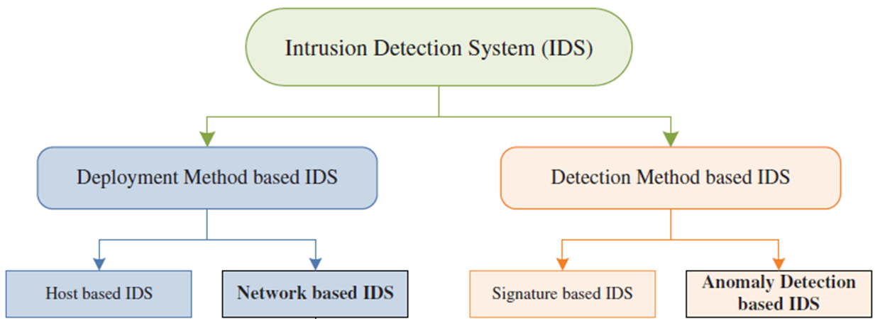
NIDS with Machine Learning
Machine learning has been used as a technique to detect anomalies in network traffic as well as novel day-zero attacks without having its signature known before.
Machine learning models that applied :
Logistic regression
Random forest
XG-Boost at binary classification and Cat-boost at multi classification

Slide 9
Data exploration

Slide 10
Dataset description
Due to the complexity in obtaining real-world labelled benign and attack network flows, researchers have generated benchmark NIDS datasets. They are made publicly available to be used in the training and testing stages of the proposed ML detection model.
There are more than 15 available NIDS datasets in this field , each containing labelled network data flows.
This dataset reflect real network benign behavior combined with synthetic attack scenarios .
The corresponding packets are captured in their native format packet capture (pcap) and certain network features are extracted.
This data is used by University of Queensland, Brisbane QLD 4072, Australia and University of New South Wales, Canberra ACT 2612, Australia
And this data is a subset of big data used , the big data has many data sets inside it , and this data is one type of it t's called NF-Ton-Iot
Its about 1,300,000 and 14 feature

Slide 11
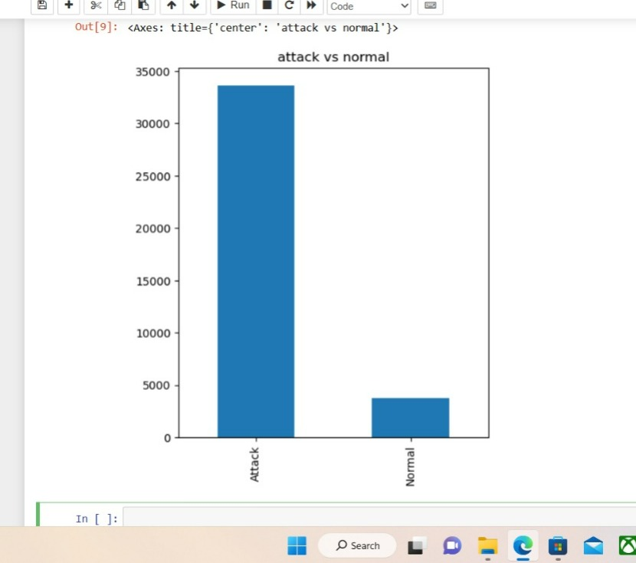
Dataset description
NF-ToN-IoT- A recent heterogeneous dataset released in 2020 that includes telemetry data of Internet of Things (IoT) services, network traffic of IoT networks and operating system logs. In this paper, we utilize the portion containing network traffic flows. The dataset is made up of a large number of attack scenarios conducted in a realistic representation of a medium-scale network at the Cyber Range Lab by ACCS.
The total number of data flows is 1,379,274 out of which 1,108,995 (80.4%) are attack samples and 270,279(19.6%) are benign ones, the table below lists and defines the distribution of the NF-ToN-IoT dataset.

Slide 12
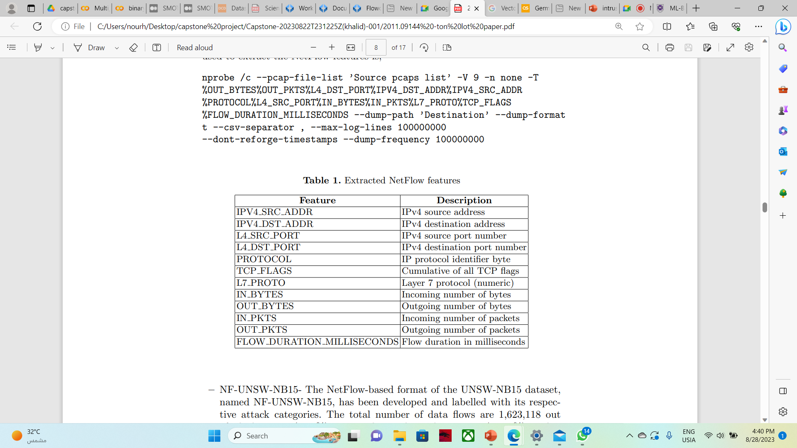
Feature Description
Collecting and recording network traffic is necessary to monitor and analyze networks.
There are two main trends for this process, capturing the complete network traffic, i.e. traffic packets, and capturing a summary of network packets in the form of flows.
While packet capturing provides full access to traffic history for the network and security analysis.

Slide 13
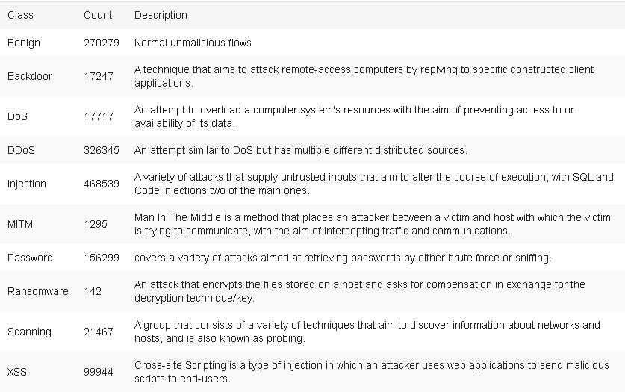
Feature Description
the table below lists and defines the distribution of the NF-ToN-IoT dataset.

Slide 14
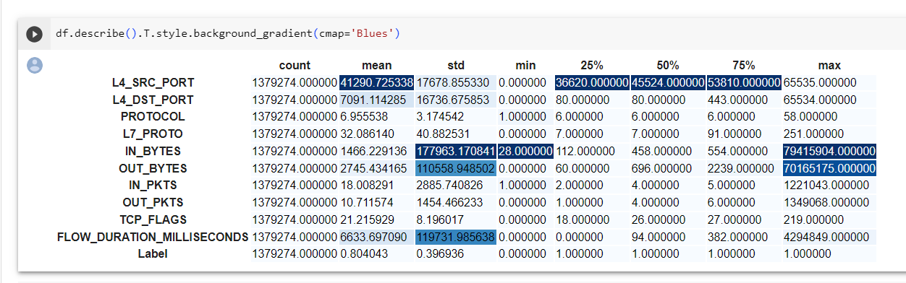
Feature Descriptions
the table below lists and defines the description the insights of the NF-ToN-IoT dataset.

Slide 15
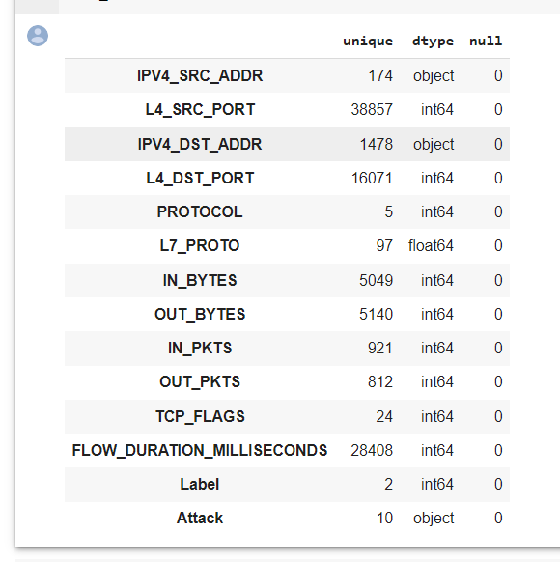
Feature Descriptions
the table below lists the counts of Unique for every feature and it shows there is Null

Slide 16
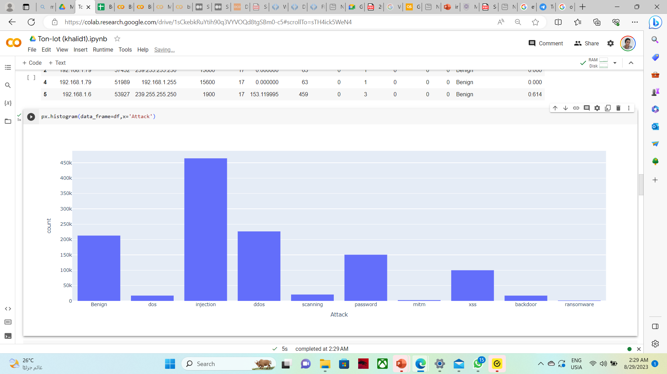
Feature Descriptions
the table below shows the number of each attack type in this Data set

Slide 17
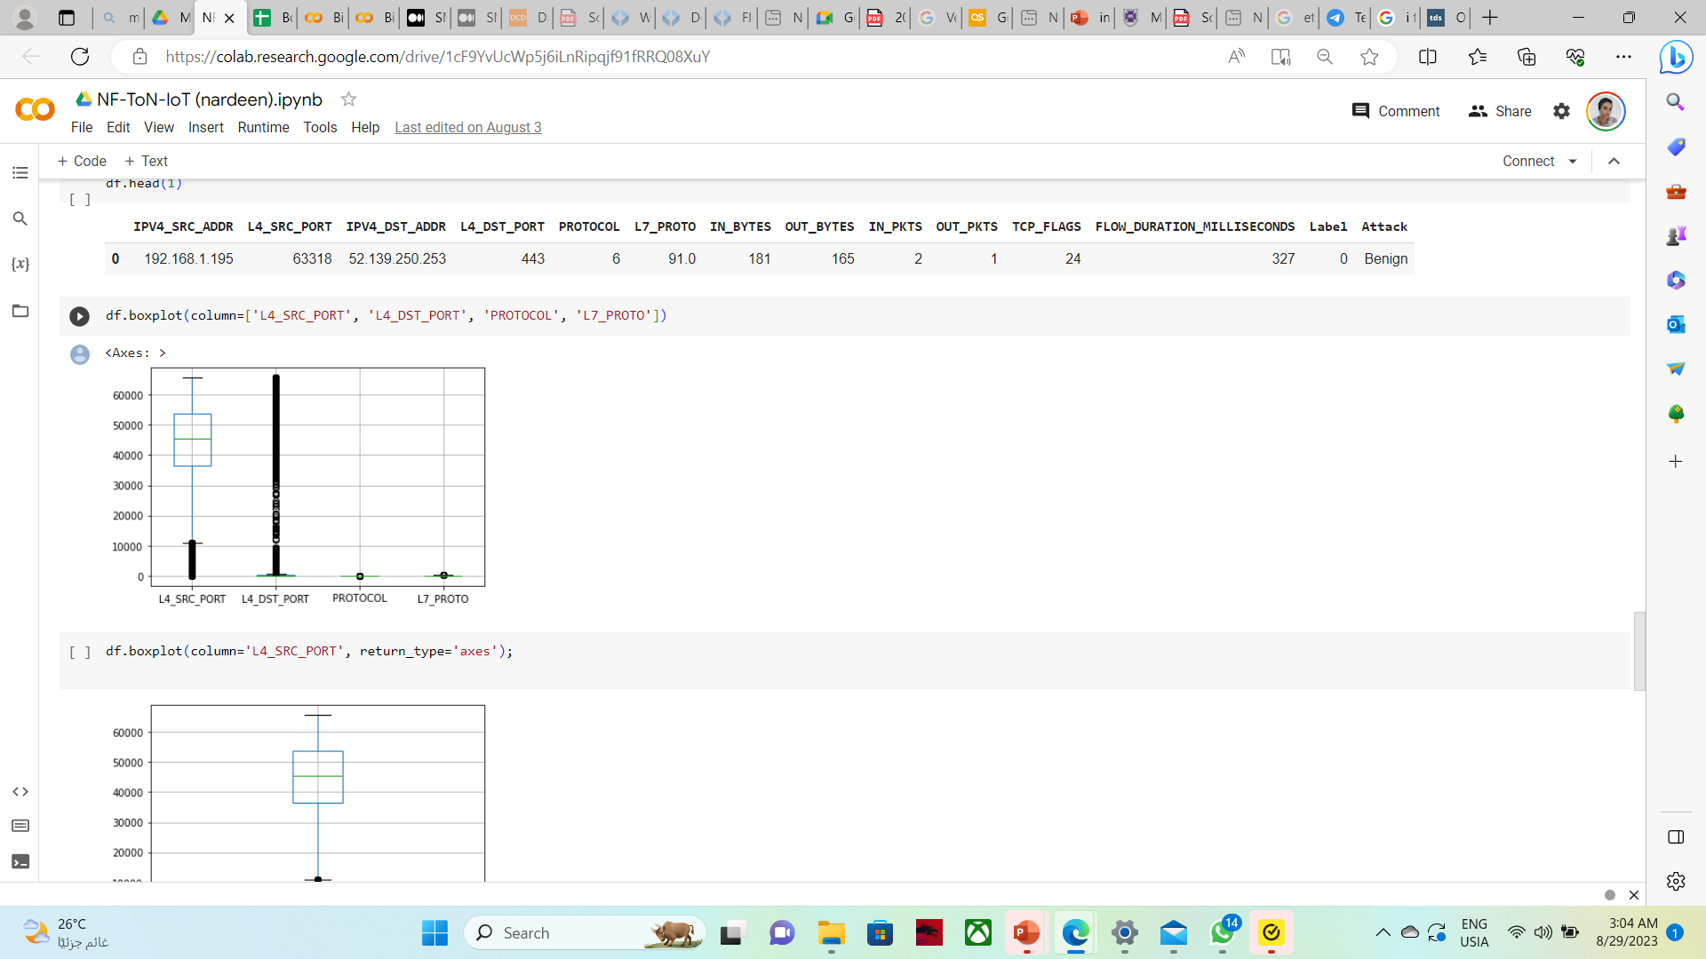
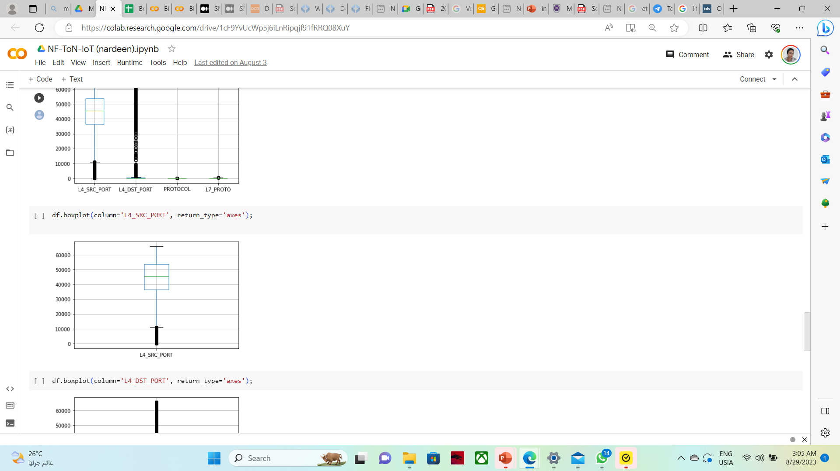
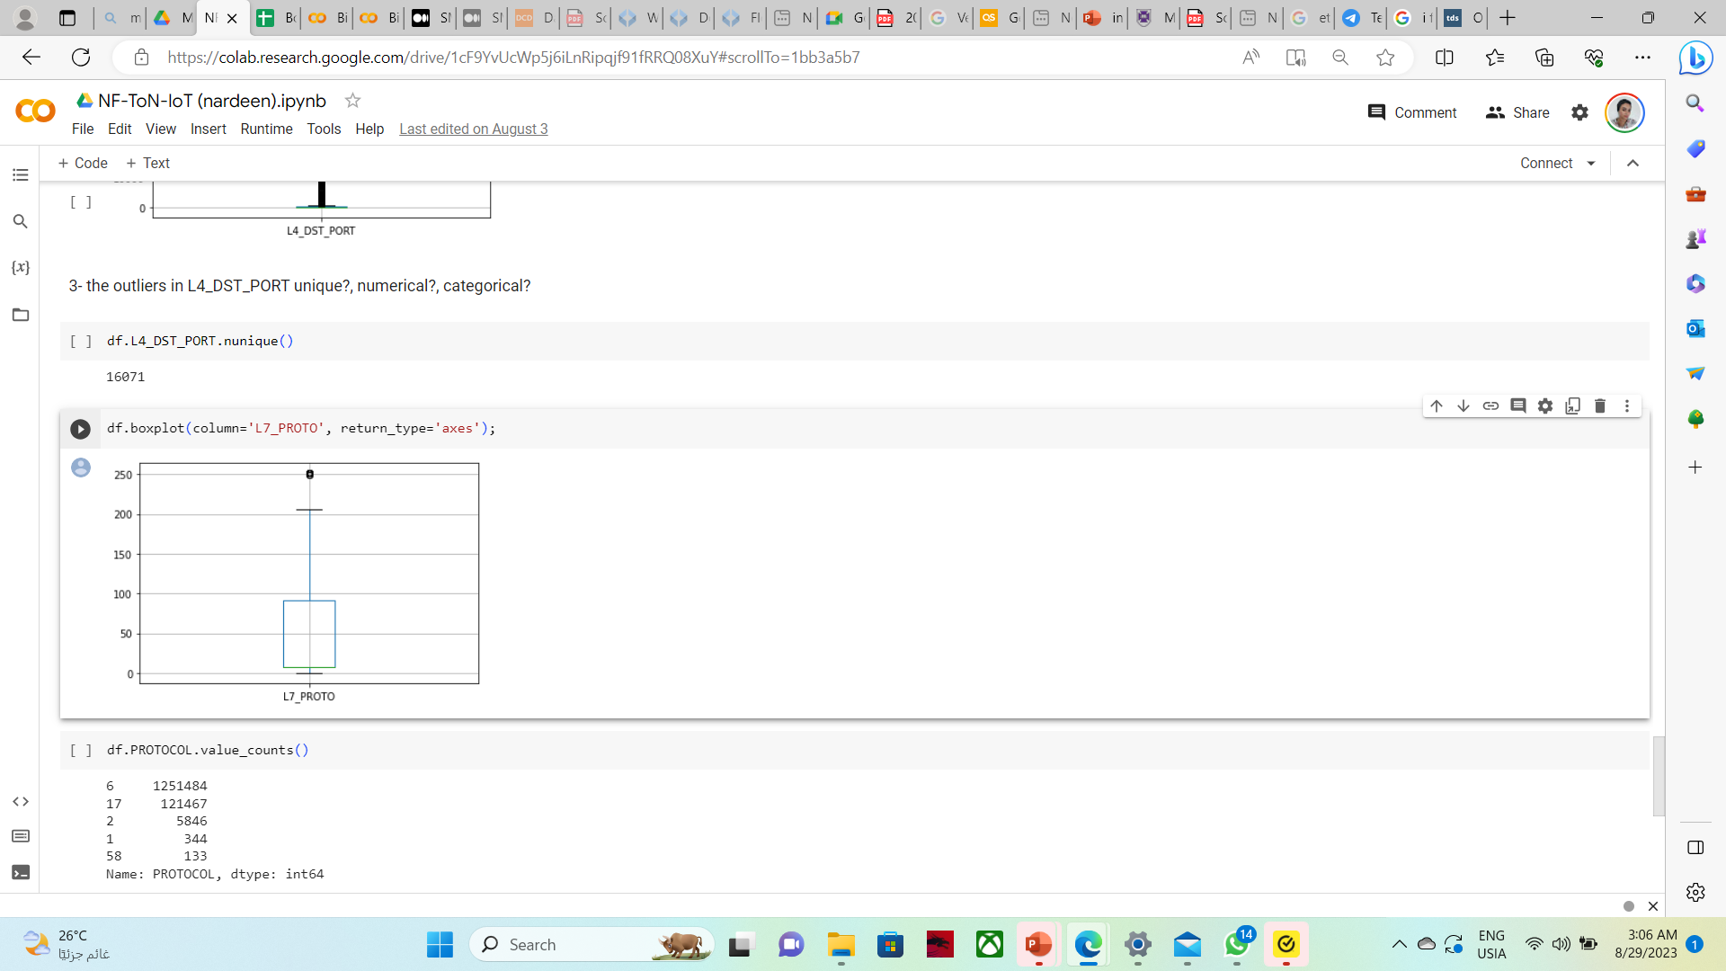
Feature Descriptions (outliers)
the table below shows the outliers

Slide 18
Data preprocessing

Slide 19
Data preprocessing
Before using the data for the machine learning model, data preprocessing is essential to make it understandable and learnable by the model. The NF-TON-IOT dataset is a clean dataset without any empty or Not a Number (NaN) entries.
But some data types are changed so it can fits different machine learning algorithms and can fits the encoding process
There is duplicate in this data and so we tend to delete it as it's typical duplicate
In principle, outliers are less frequent than regular observations (less than 5%)and are different from them in terms of values (they lie further away from the regular observations in the feature space). That is why by using such random partitioning they should be identified closer to the root of the tree (shorter average path length, i.e., the number of edges an observation must pass in the tree going from the root to the terminal node), with fewer splits necessary.
I forest technique is used to handle the outliers and thus we didn't loss the data

Slide 20
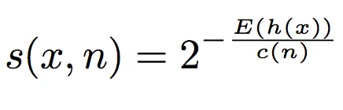
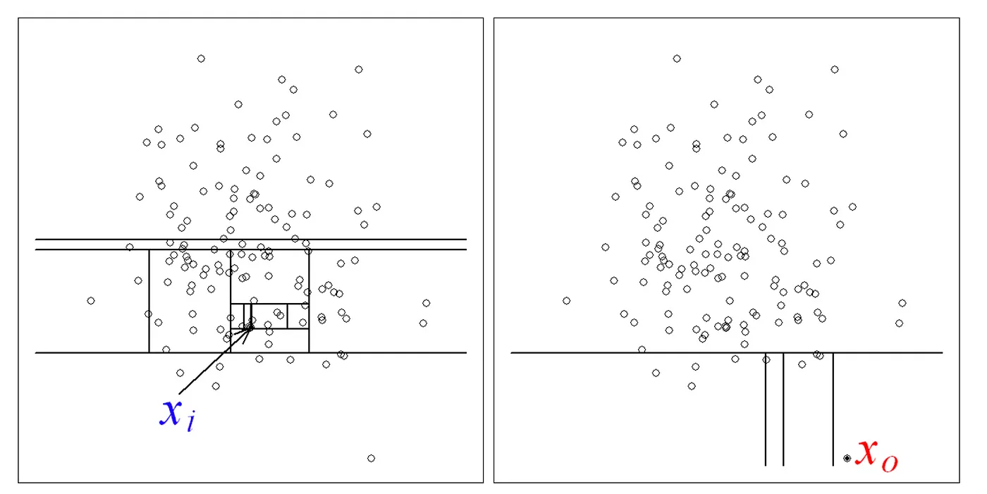
Data preprocessing
As with other outlier detection methods, an anomaly score is required for decision making. In the case of Isolation Forest, it is defined as:
where h(x) is the path length of observation x, c(n) is the average path length of unsuccessful search in a Binary Search Tree and n is the number of external nodes.
Each observation is given an anomaly score and the following decision can be made on its basis:
A score close to 1 indicates anomalies.
Score much smaller than 0.5 indicates normal observations.
If all scores are close to 0.5 then the entire sample does not seem to have clearly distinct anomalies.
Figure 1 Identifying normal vs. abnormal observations

Slide 21
Data preprocessing
After applying the Isolation forest Algorithm it turns out that the number of outliers for all multivariate data are 140 observations.
Referring to the high variance of data it was concluded that most of the outliers points were not actual outliers, but it had to be analyzed and included in the training process of the ML model.

Slide 22
Data preprocessing (splitting IP address)
Some features like 'IPV4_SRC_ADDR' and 'IPV4_DST_ADDR' types are string in the original data , and the research made by Queensland university they drop these features, but here in this research it's preferred to split these field each into 4 columns so we can be deployed at ML ,especially the IP addresses are not unique and a lot are repeated .

Slide 23
Data preprocessing
Encoding
ML learning models only understand numeric values, that’s why the nonnumeric attributes have to be encoded in some way to be understood by the model.
Label Encoding
it is a technique that is used to convert categorical columns into numerical ones so that they can be fitted by machine learning models which only take numerical data. It is an important pre-processing step in a machine-learning project.
Label Encoding is applied on the TON-IOT dataset on the target column (label)which is Species. It contains two species attack and normal in binary classification.
AS well get dummies is applied on ['PROTOCOL','TCP_FLAGS'] as it's categorical and as
pandas.get_dummies() is used for data manipulation. It converts categorical data into dummy or indicator variables.

Slide 24
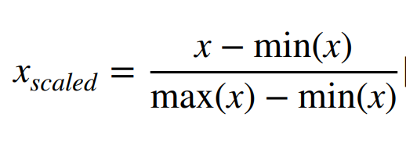
Data preprocessing
Normalization:
Scaling the data is an important part of data preprocessing in ML learning by mapping the values into a specific range. This process helps the ML learning model and speeds up the training process. Scaling can be achieved using normalization, where one of the most common normalizers is the Minmax Scaler from the scikit-learn library which was used in this work. The normalization is done by subtracting each value from the minimum value in its column and dividing by the range (Max value–Min value) as shown in Eq. 1. Several normalizers were tested in the process of this research; eventually, Minmax Scaler was chosen for providing best results.
After applying encoding and normalization on the train dataset, two approaches are implemented. The first approach is to train on the entire TON-IOT dataset and use the TON-IOT Test as the testing dataset. The second approach is to split the TON-IOT Train dataset into a 75%, 25% parts and use the 75% for training and 25% for testing. In both cases, the test dataset is a set of samples that have not been seen while training the model
The over way is to use k-fold cross validation where CV=5 and test data by shuffle

Slide 25
Addressing the class imbalance problem in network intrusion detection systems using data resampling
When a class is underrepresented in a dataset, this causes the dataset to be imbalanced. Detecting the minority class becomes a difficulty which lowers the performance of the intrusion detection system.
The NF-TON-IOT dataset has much more attack samples than the normal samples.
Techniques used to handle class imbalance:
Random oversampling
Smote
Adasyn

Slide 26
Addressing the class imbalance problem in network intrusion detection systems using data resampling
Random over sampling
This is the technique in which we select random points from the minority class and duplicate them to increase the number of data points in the minority class. But is considered to be the most robust out of all. This method is considered to be the most basic oversampling technique. Since the selection of the points is random this artificially creates a reduction in the variance of the dataset.
SMOTE over sampling
SMOTE stands for Synthetic Minority Oversampling Technique. This technique generates new observations by interjecting a point between observations of the original dataset. It makes use of the K-Nearest Neighbors strategy, an easy to use model selection framework is supplied to enable the rapid evaluation of oversampling techniques on unseen datasets.

Slide 27
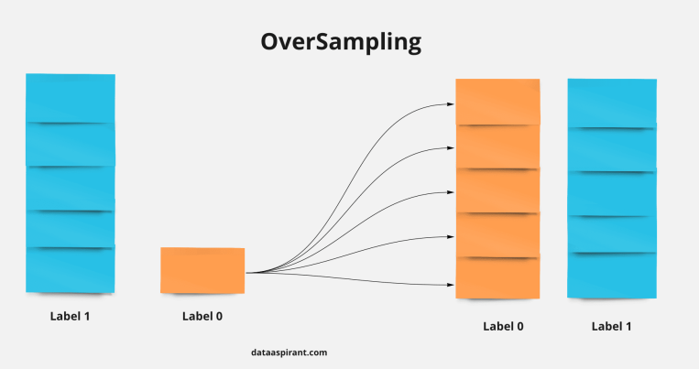
Addressing the class imbalance problem in network intrusion detection systems using data resampling
Adasyn over sampling
the Adaptive Synthetic Sampling Approach. This approach is based on the methodology of SMOTE but instead of generating points from nearby points its uses outlier points i.e. “harder-to-learn-from” to generate new points. But the drawback of this is that due to its adaptive nature its precision gets affected. Also for minority examples that are scattered, each neighborhood may only contain 1 minority example.
Pros:
(1) This method doesn’t lead to information loss
(2) Performs well and gives good accuracy
Cons:
(1) Increase of Learning Time
(2) Tends to Overfitting

Slide 28
Binary-Class Classification

Slide 29
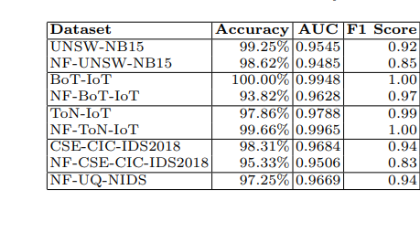
In this experiment, we evaluate the attack detection performance of the NetFlow datasets compared to the NF-TON-IOT. This table lists the accuracy, AUC, F1 score.
According to the queens land scientific paper The NF-ToN-IoT’s dataset performance was superior to its other data sets of the same branch of TON-IOT, achieving a 99.67% accuracies as shown
The table below shows the accuracy of different data sets and NF of these data sets

Slide 30
So ,in our research we apply different machine learning models on the NF-TON-IOT dataset with applying different sampling techniques.
Those ML models are applied on:
No over sampled data
Random over sampled data
SMOTE sampled data
Adaysn sampled data
The below table shows the accuracy score with splitting data into 75% train and 25% test
binary-class classification data splitting on 25% | logistic regression | Random forest | Xg-boost
No over sampled data | 0.9902 | 0.9998 | 0.999
Random over sampled | 0.9844 | 0.9999 | 0.9999
smote over sampled | 0.9852 | 0.9999 | 1.0
Adysn over sampled | 0.9999 | 0.9999 | 0.9997

Slide 31
The table shown is the result of applying ML model at the data with K-fold cross validation
cross validation cv=5 | logistic regression | Random forest | Xg-boost
No over sampled data | 0.99910 | 0.9998 | 0.99997
Random over sampled | 0.985 | 1 | 1
smote over sampled | 0.9955 | 0.999 | 0.999
Adysn over sampled | 1.0 | 1.0 | 0.999
The results are improves very well on applying over sampling techniques to give 100% precision and recall in the binary classification.
As we tested the data with k-fold validation (cv=5) and the data accuracies are slightly improved.

Slide 32
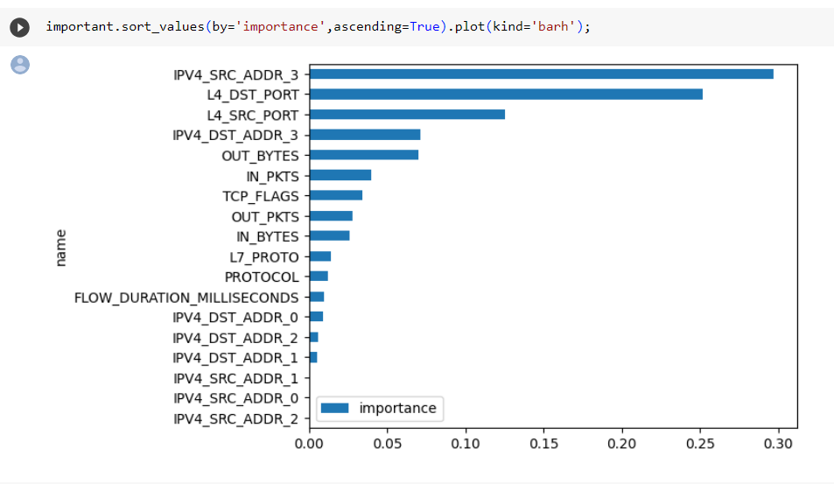
It's shown that the recent research we made at original NF-TON-IOT (no over sampled data) are slightly performed than original data at (25-75%)splitting and this due to a stage on data pre-processing. we didn't drop IP address and consider it as unique address as it's not unique and repeated , so we split it as to be numeric and not categorical. And this improve ML results at NO over sampled data
And this proved by importance features we made in binary-class classification for a Random Forest model.

Slide 33
multi-Class Classification

Slide 34
Dropping normal traffic In the case of multi-class classification, the normal traffic is dropped from both the train and test datasets. This is implemented to let the model focus more on classifying the attack type without confusing it with a normal sample. This is done under the assumption of having two-stage NIDS which will first identify an attack then identify its type. The distribution of the dataset samples after dropping normal traffic .
Thus ML models are applied on:
No over sampled data
Random over sampled data
SMOTE sampled data
ADAYSN sampled data
Also PCA technique is applied to SMOTE and ADAYSN data to view different accuracies comparison

Slide 35
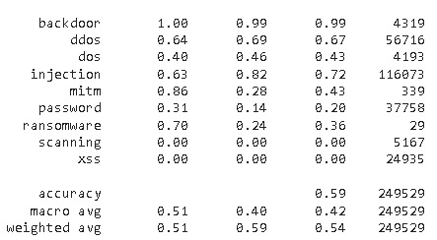
No-over-sampler
At logistic regression algorithm with NO oversampled data the percentage of classes are 59%
Logistic regression with NO over sampler

Slide 36
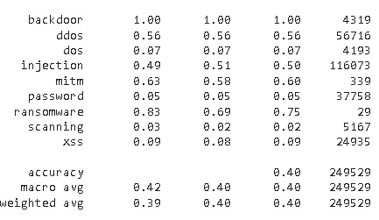
No-over-sampler
At Random-Forest algorithm with NO oversampled data the percentage of classes are 40% accuracy
Random Forest with NO over sampler

Slide 37
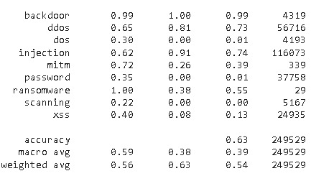
No-over-sampler
Gradient-boost with NO oversampled data the percentage of classes are accuracy 63%
Gradient Boost with NO over sampler

Slide 38
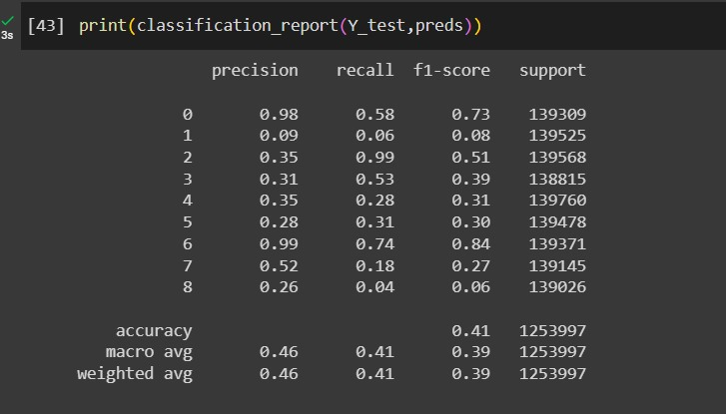
SMOTE-sampler
Logistic regression with SMOTE oversampled data the percentage of classes are accuracy 41%
Logistic regression SMOTE over sampler

Slide 39
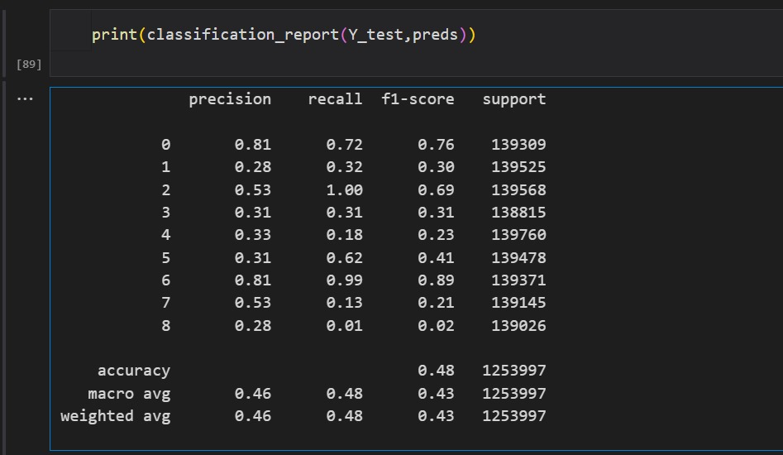
SMOTE-sampler with PCA
Logistic regression with SMOTE oversampled data and PCA the percentage of classes are accuracy 48% slightly improved compared to original SMOTE 41%
Logistic regression SMOTE over sampler and PCA

Slide 40
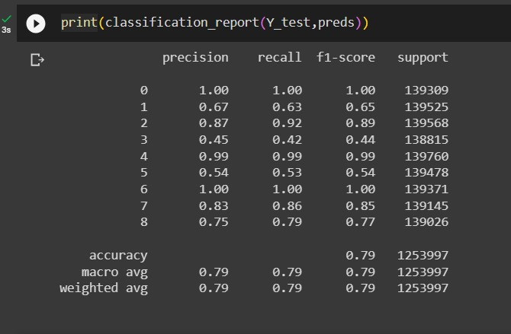
SMOTE-sampler
Random forest with SMOTE oversampled data the percentage of classes are accuracy79%
Random-Forest SMOT over sampler

Slide 41
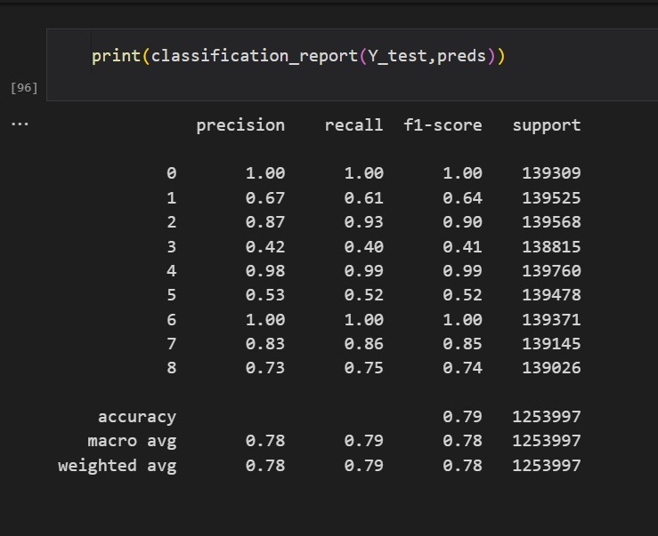
SMOTE-sampler with PCA
Random forest with SMOTE oversampled data with PCA the percentage of classes are accuracy 79% and it's the same without PCA 79%
Random-Forest SMOTE over sampler with PCA

Slide 42
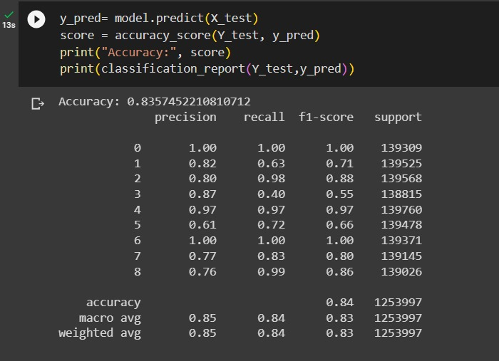
SMOTE-sampler
CAT-BOOST with SMOTE oversampled data the percentage of classes are accuracy 84%
Cat-Boost regression SMOTE over sampler

Slide 43
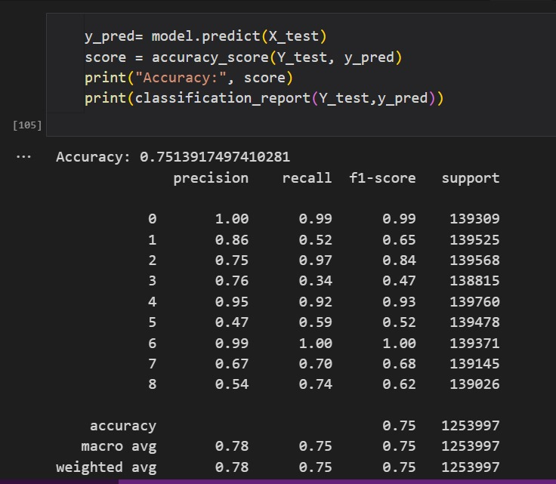
SMOTE-sampler with PCA
CAT-BOOST with SMOTE oversampled data with PCA the percentage of classes are accuracy 75 % and it's worst than without PCA 84%
Cat-Boost regression SMOT over sampler

Slide 44
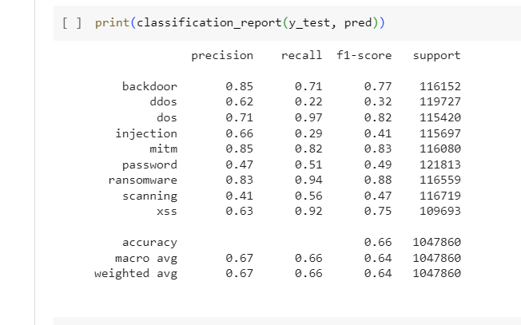
ADASYN over-sampler
At logistic regression algorithm with ADASYN the percentage of classes are slightly improved it gives 65% rather than 59% with no over sampled data
Logistic regression with ADAYSN over sampler

Slide 45
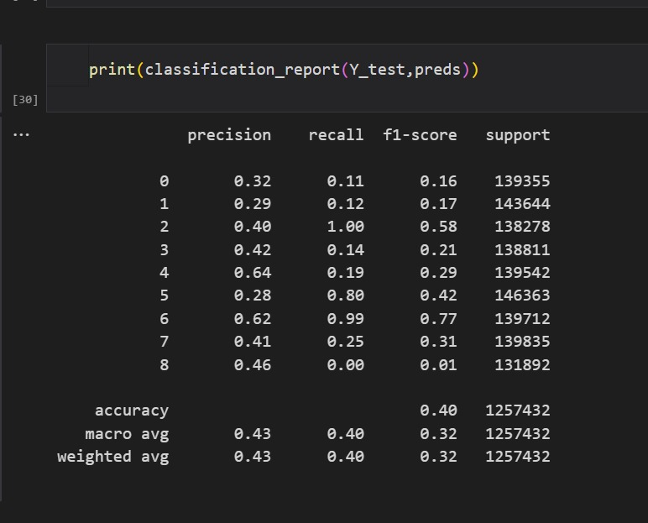
ADASYN over-sampler with Pca
Logistic regression with ADASYN after applying PCA the percentage of classes didn’t improve it gives accuracy 40% rather than ADAYSN alone 65%
Logistic regression with ADYSN over sampler after applying PCA

Slide 46
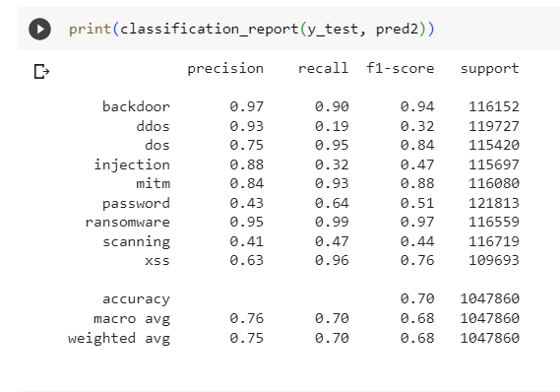
ADASYN over-sampler
At Random Forest algorithm with ADASYN the percentage of classes are slightly improved, it gives 70% rather than 40% with no over sampled data
Random Forest with ADAYSN over sampler

Slide 47
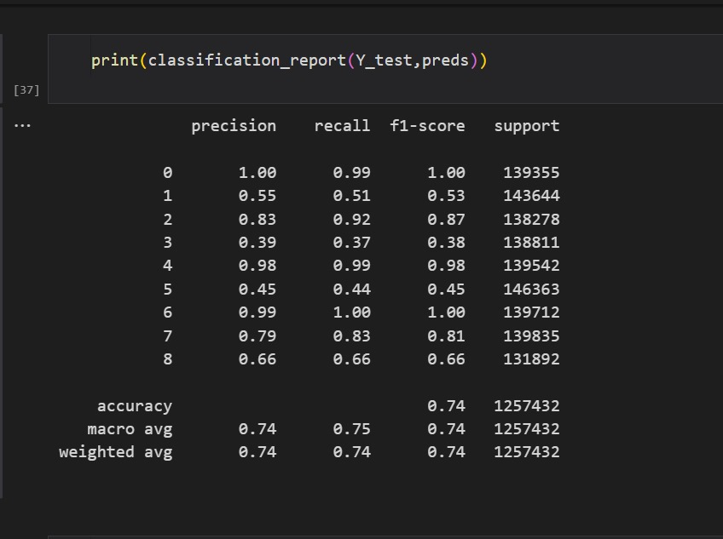
ADASYN over-sampler with Pca
Random Forest with ADASYN after applying PCA the percentage of classes are improved it gives accuracy 74% rather than ADYSN alone 70%
Random forest with ADAYSN over sampler after applying PCA

Slide 48
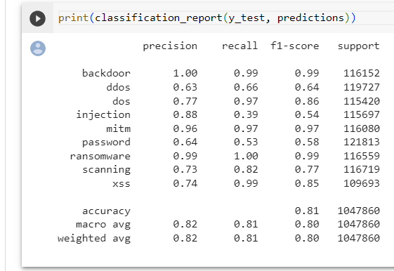
ADASYN over-sampler
CAT_BOOST with ADASYN the percentage of classes are strong improved it gives 81%
CAT-BOOST with ADAYSN over sampler

Slide 49
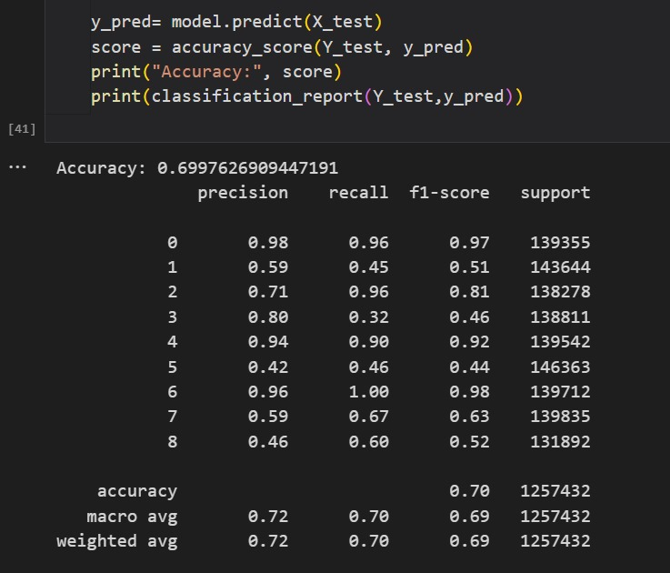
ADASYN over-sampler with Pca
CAT-BOOST after applying PCA the percentage of classes doesn't improved it gives accuracy 70% rather than ADAYSN alone 81%
CAT-BOOST with ADAYSN over sampler after applying PCA

Slide 50
It's noticed that the best machine learning algorithm is CAT-BOOST after applying SMOTE over-sampling by accuracy 84%
data splitting on 25% | logistic regression | Random forest | XG-boost
No over sampled data | 0.59 | 0.401 | 0.63
smote over sampled | 0.41 | 0.79 | 0.84
ADYSN over sampled | 0.6579 | 0.701 | 0.8103
Results on applying PCA with SMOTE and ADAYSN over sampler
multi-class classification with PCA data splitting on 25% | logistic regression | Random forest | XG-BOOST
SMOTE over sampled | 0.48 | 0.79 | 0.75
ADAYSN over sampled | 0.4 | 0.74 | 0.7

Slide 51
Links to our dataset and references:
Queens Land University dataset: https://staff.itee.uq.edu.au/marius/NIDS_datasets/
. Claise, B., Sadasivan, G., Valluri, V., Djernaes, M.: Cisco systems NetFlow services export version 9 (2004)
. Moustafa, N.: Ton-iot datasets (2019). https://doi.org/10.21227/fesz-dm97, http://dx.doi.org/10.21227/fesz-dm97
Cisco Systems: Cisco IOS NetFlow Version 9 Flow-Record Format - White Paper. https://www.cisco.com/en/US/technologies/tk648/tk362/technologies_ white_paper09186a00800a3db9.pdf (2011
Shiravi, A., Shiravi, H., Tavallaee, M., Ghorbani, A.A.: Toward developing a systematic approach to generate benchmark datasets for intrusion detection. Computers & Security 31(3), 357 – 374 (2012). https://doi.org/https://doi.org/10.1016/j.cose.2011.12.012, http://www.sciencedirect.com/science/article/pii/S0167404811001672

Slide 52

Thank you very much

